Slide 1
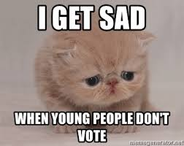
Hopeful storytelling
for a better future
Basics & research

Slide 2
Basics: Storytelling to create change
WHY Stories?
WHO is your target?
HOW do you say it?
WHO says it?
Values
Urgency vs hope

Slide 3
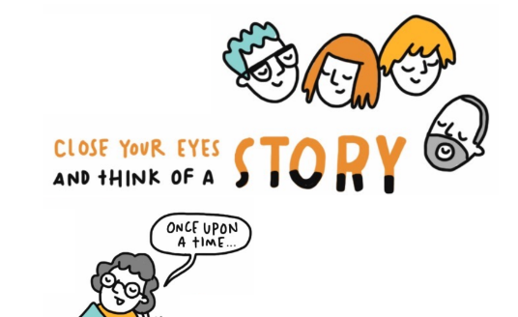
WHY Stories?
We need to convince people to make a change
Stories have the power to do that
They have universal structures and values that speak to people of different backgrounds
They can make a better future graspable

Slide 4
1. WHO is our target?
Identify your audience
Base Eg your YFoEE pals
Moveable middle Eg your ex-schoolmates
Target Eg EU decision makers
Opponents Eg fascist idiots

Slide 5
2. HOW do you say it?
Capacity building event of young multipliers for a sustainable, democratic Europe
FRAMING

Slide 6
2. HOW do you say it?
Young Activists
Comms Camp
FRAMING

Slide 7
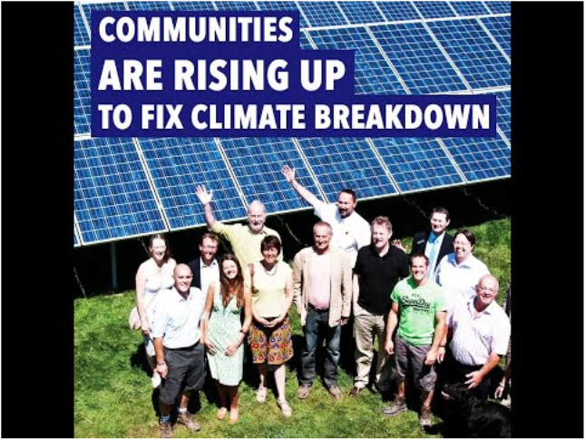
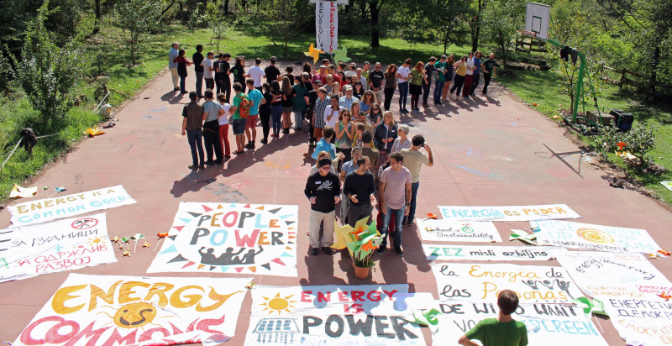
Visual Framing

Slide 8
FRAMING
Is more
Than a 1000 Words

Slide 9
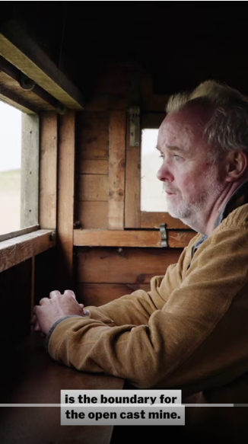
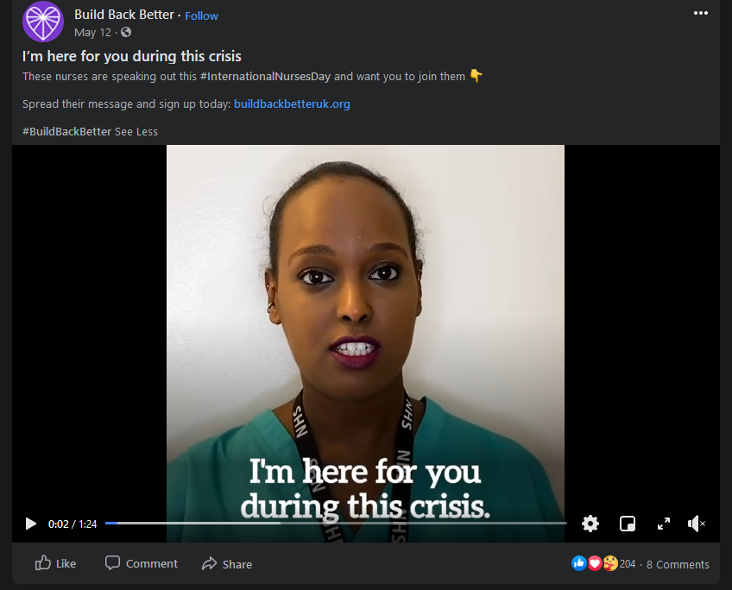
3. WHO says it?
Authentic voices make it relatable

Slide 10
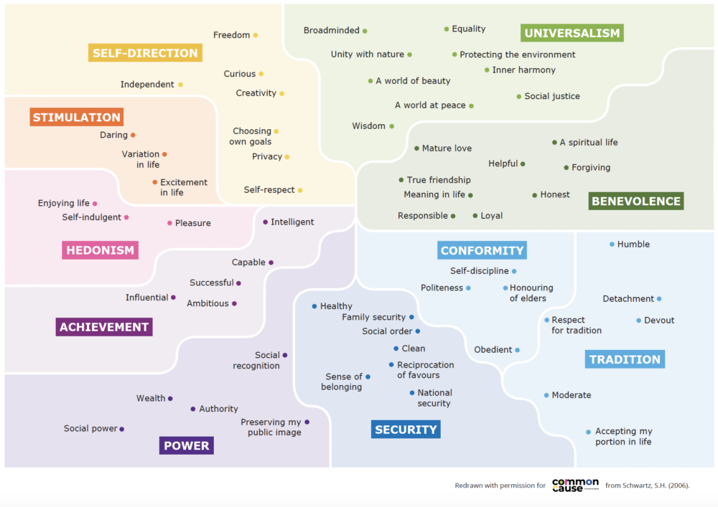
4. Which VALUES are you speaking to?

Slide 11
5. How much HOPE and URGENCY is in the mix?

Slide 12
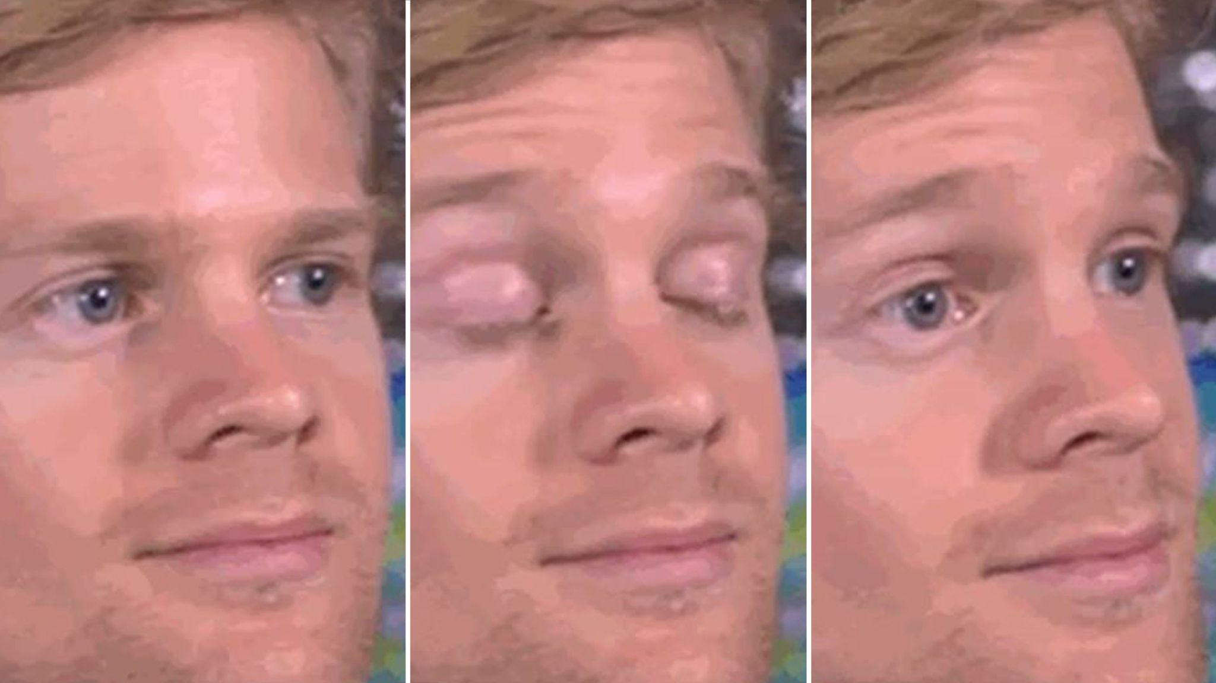
Let’s discover messaging
With new eyes

Slide 13
Friends of the Earth Europe 2019: How to talk about the societies we want in Europe. NGO brainstorm, testing in Austria, Croatia, Denmark, France, Poland
Climate Outreach 2022: Communicating climate justice with young adults in Europe. Survey of 18-35 yo (broad audience) in 6 EU countries Focus groups 18-29 yo (left-leaning) in 9 countries
Audience research

Slide 14
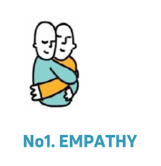
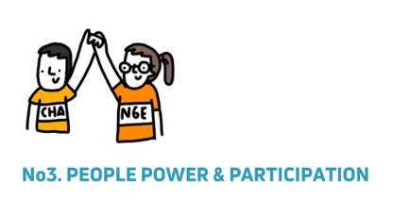
FoEE Study
And these values
were the winners!!
If we act together, we can create a better, more equal and caring world.

Slide 15
FoEE Study
VALUES of empathy, equality, and participation / people power
CHANGE
INDIVIDUALS esp. real ‘relatable’ people
Not one hero, but people working together
overcoming the odds, David vs Goliath style
Some element of surprise
be clear and simple
small to big picture
Beware of the ELEPHANT
Tips for hopeful stories

Slide 16
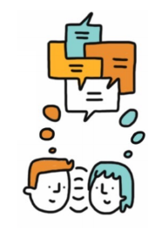
FoEE Study
Let’s talk about it!
It’s not enough to broadcast messages – we need conversations
They connect people, let them express their hopes and ideas and be heard
Possible Questions: What do you care about? What gives you hope? What could more caring communities look like?
Possible places…
Storytelling techniques

Slide 17
Climate Outreach
Tips for talking about
Climate justice
Clarify how climate change worsens inequalities
lived experience = climate expertise
Avoid images or frames that show marginalised people as passive victim

Slide 18
Climate Outreach
Tips for talking about
Climate justice
Explain how the past has led to the present
eg colonialism
Celebrate wins of the past, eg women’s strikes
Who’s the problem? Common enemy

Slide 19
YOUR TURN
Go back to your group
Make a video concept
Think about: Target, Goal, values, key message, channel, style
Get it on a flipchart
You have 20 minutes

Slide 20
Framing Sushi – for inspiration
Tell it to a 5-year-old
Make a Meme
Add more people
Write a tweet
Make common ground
Tell me what I can do
Express connection
Make us laugh
Take a new perspective
Say it in 10 words
Link to a current topic
Tell it to your grandma
Challenge a stereotype
Take something away
Break composition rules

